Slide 1

Final Project Report
Bank Marketing Campaign
12-October-2021

Slide 2

Executive Summary Problem Statement Approach
Agenda
EDA
EDA Summary
Model performance
Recommendations

Slide 3
Executive Summary
*ABC Bank wants to sell it's term deposit product to customers.
*By analyzing the clients data we try to understand what are the patterns on opting for the policy.
*17 different attributes where considered to perform the analysis.
*The data had information of 45211 customers who purchased and who did not purchase for the policy.
*Analysis was primarily focused on the customers who purchased the policy.

Slide 4
Problem :
*Identify the age group, marital status, education level, job description of customers who purchase the policy.
*What is the purchase pattern for the policy throughout the year.?
*Does contacting the customer before or after the campaign beneficial for the company?
*What is average time taken for communication by a client who purchases the policy?

Slide 5
Approach
1.Understanding the Data.
2.Purchase of policy over time.
Duration Analysis
2.Recommendation
Assumption:
The data sample that which is given is independently and randomly sampled and it’s a true representation on population.

Slide 6
Exploratory Data Analysis (EDA)
Summary
 | Age | Duration
mean | 40.93 | 258.16
std | 10.61 | 257.52
min | 18 | 0
50% | 39 | 180
max | 95 | 4918
1.On average the age of the clients is 40.
2.The age group selected for this campaign is from 18-95.
3.The maximum communication time spent with a customer is 4918 seconds.

Slide 7
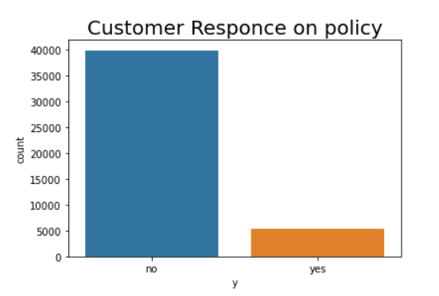
Customer Analysis
.
There are total 5289 customers purchased the policy and 39922 customers who didn’t take the policy.

Slide 8
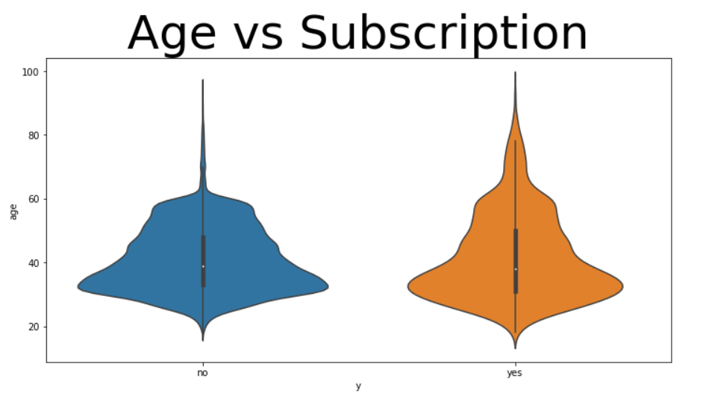
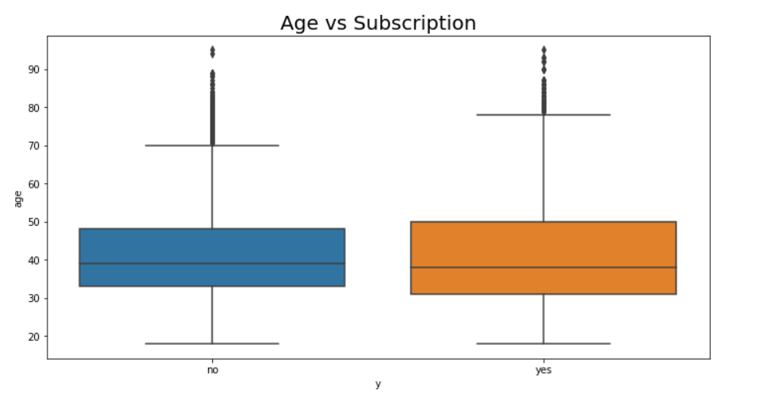
Customer’s Age Analysis

Slide 9
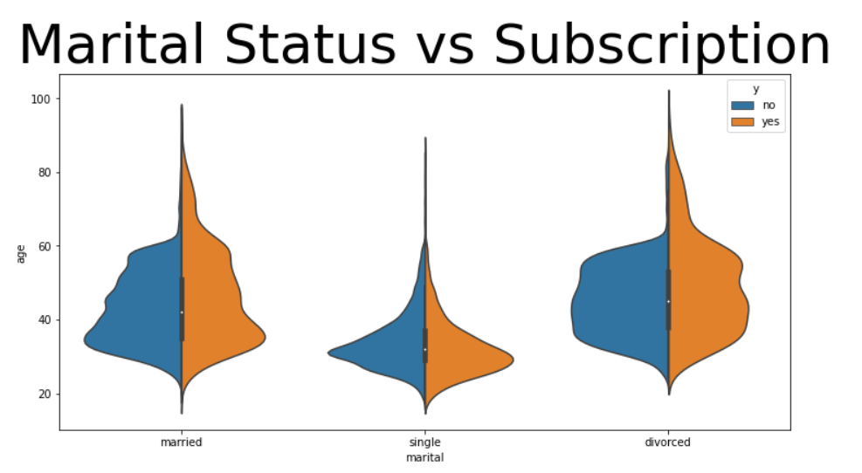

Slide 10
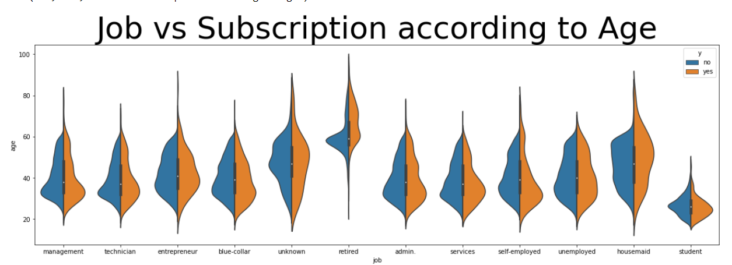
Clients who buy the policy are more likely to fall between the age of 20-40 there are more number of clients beyond age of 60 who have bought the policy and median for no policy is higher. Retired clients are more likely to buy the policy.

Slide 11
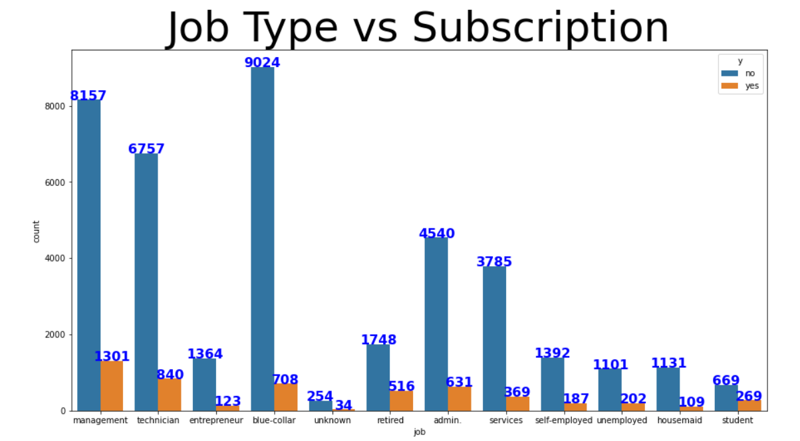
Policy Purchase according to Job Type
Purchase percentage:
Management = 13%
Technician = 11%
Entrepreneur = 8%
Blue Collar = 7%
Unknown = 11%
Retired = 23%
Admin = 12%
Services = 9%
Self Employed = 12%
Unemployed = 15%
Housemaid = 9%
Student = 29%
Clients who have their job description as management are more likely to opt for the policy and with unknown least.

Slide 12
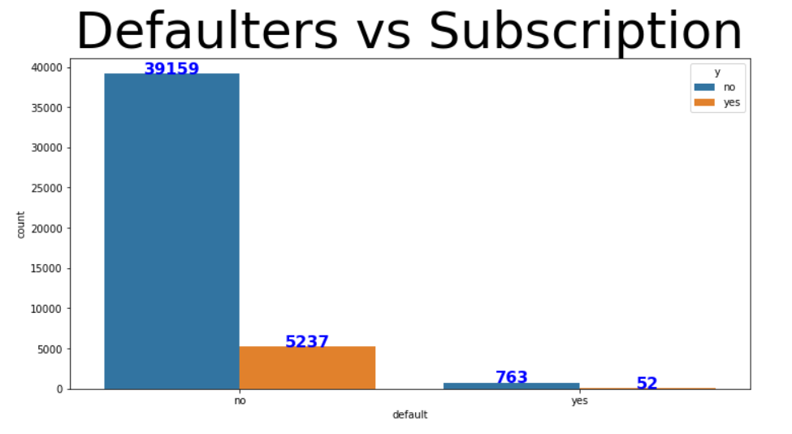
Financial Status of Clients
Clients who do have default as their status are less likely to buy the policy

Slide 13
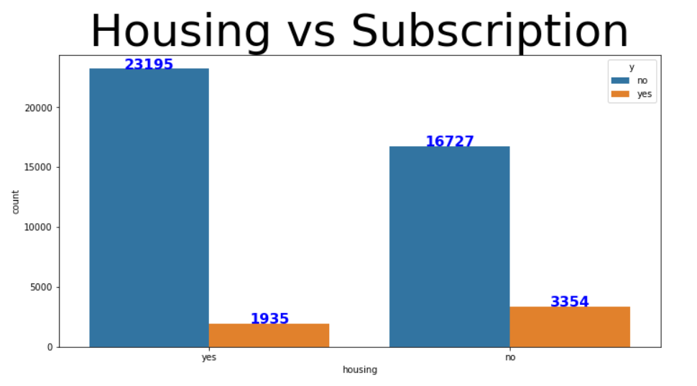
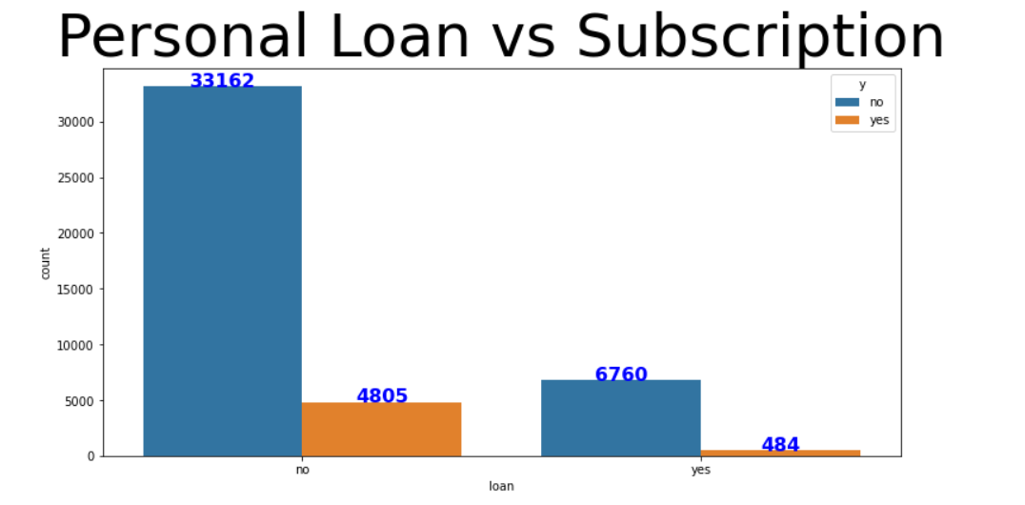
Irrespective of their housing loan status there is a small diffrence(26%) between clients who have and not have housing loan and yet apply for the policy.

Slide 14
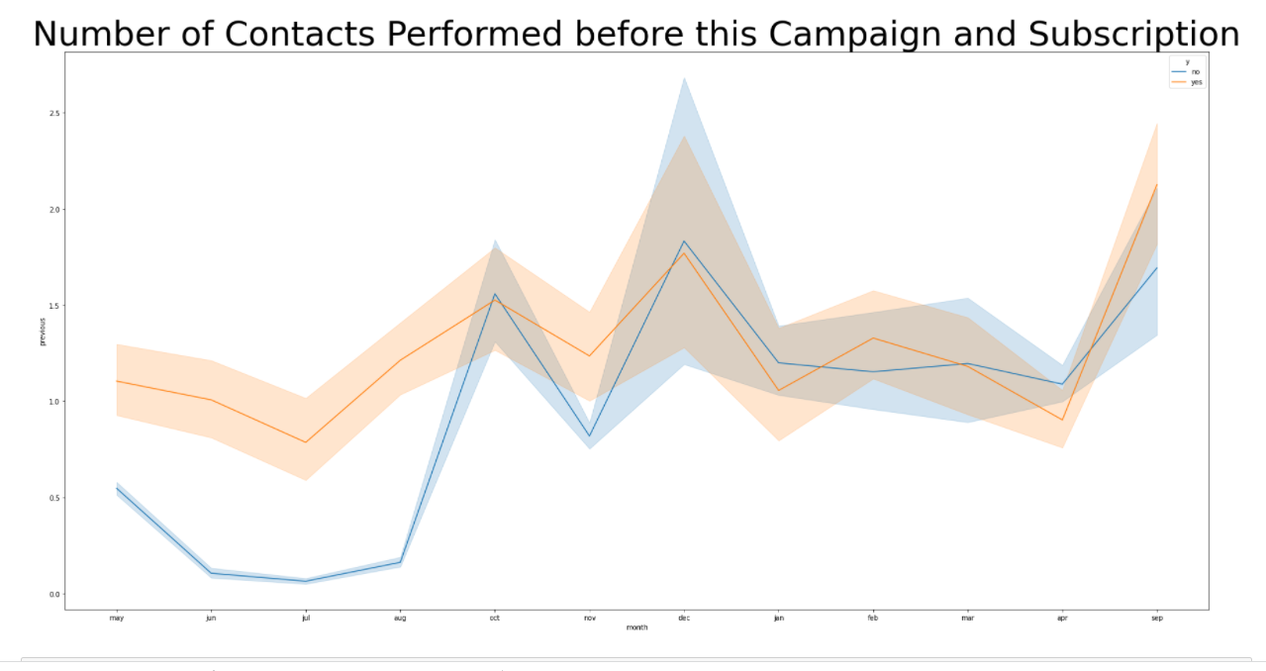
Contact with Customer Analysis
Customers are more likely to go for policy from May to October. Thus contact before the campaign brings more customers

Slide 15
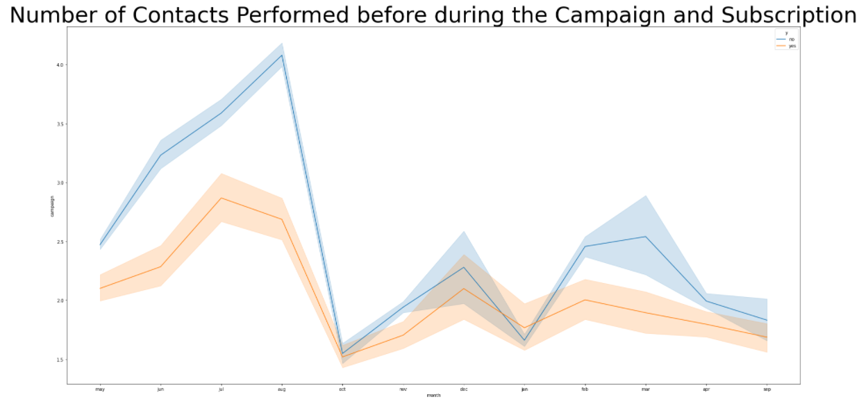
Positive subscription to the policy during the campaign does not outnumber the failure to subscription. However December month is favorable to out variable of interest.

Slide 16
Model Performance
Model | Accuracy | Precision |  | Recall |  | F1 score
 |  | 0 | 1 | 0 | 1 | 0 | 1
Logistic Regression | 0.94 | 0.91 | 0.97 | 0.97 | 0.91 | 0.94 | 0.94
Decision Tree | 0.93 | 0.93 | 0.92 | 0.92 | 0.93 | 0.93 | 0.93
XG boost | 0.95 | 0.95 | 0.95 | 0.95 | 0.94 | 0.95 | 0.95
Light GMB | 0.91 | 0.93 | 0.63 | 0.96 | 0.47 | 0.95 | 0.57
Random forest | 0.95 | 0.94 | 0.96 | 0.96 | 0.94 | 0.95 | 0.95
The best performing Models are XG boost and Random forest both have similar score so either of these model can be used.

Slide 17
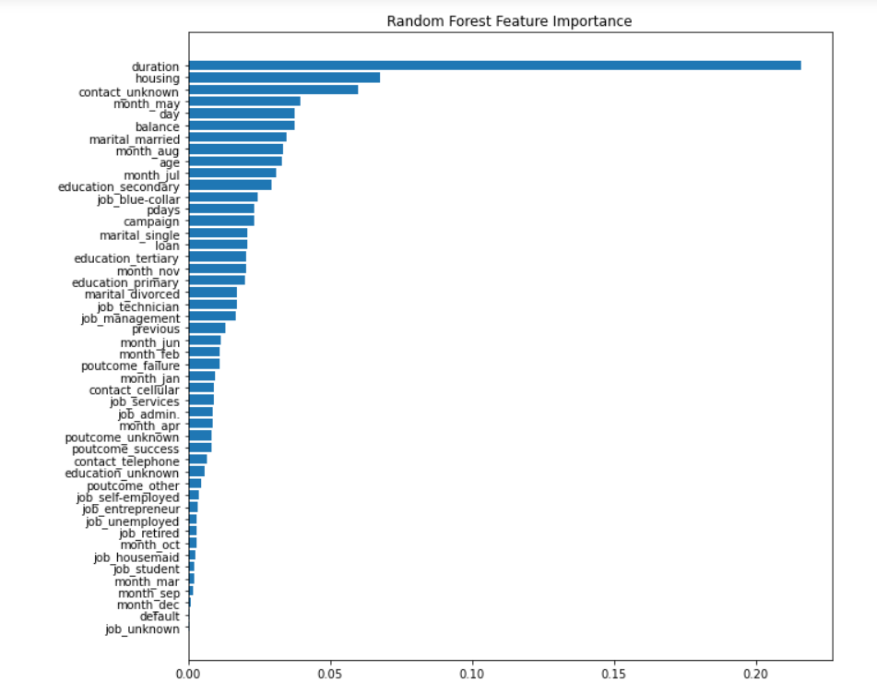

Slide 18
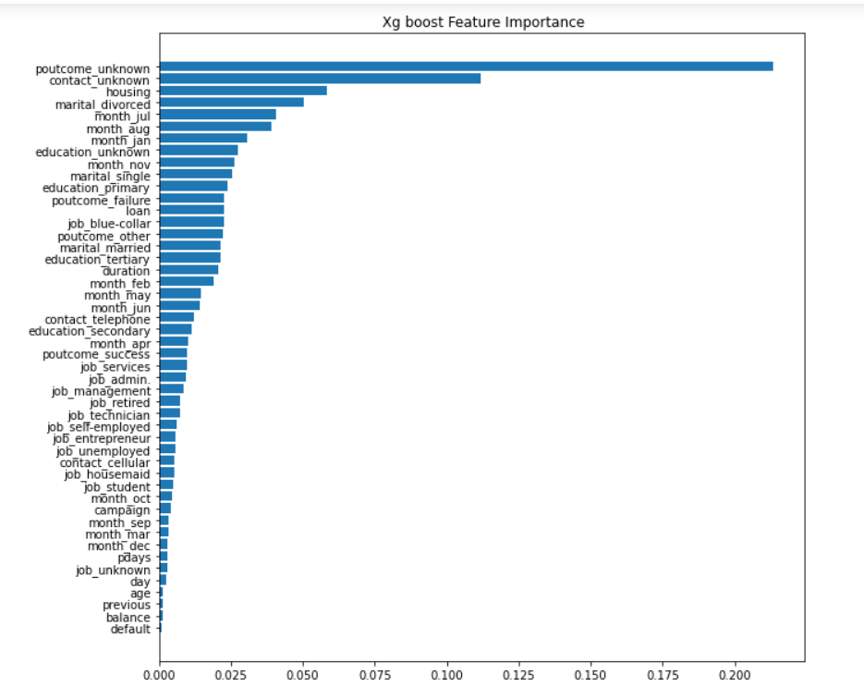

Slide 19
Recommendations
1.Clients who buy the policy are more likely to fall between the age of 20-40 there are more number of clients beyond age of 60 who have bought the policy and median for no policy is higher. Retired clients are more likely to buy the policy.
2.Clients who do have default as their status are less likely to buy the policy.
3.Irrespective of the housing loan status there is a small difference(26%) between clients who have and not have housing loan and yet apply for the policy.
4Clients with secondary and tertiary education are more likely to opt for the policy.
5.On average the call lasts for 426 seconds for the clients who opted for the policy and for clients who did not opt for policy the call lasted for 164 seconds which is lesser than clients who opt for policy. Thus clients spend more time on communication when they opt for the policy.
6.Clients are more likely to opt for policy from the month of May to October also in the month of September. Thus contact before the campaign brings more clients to opt for the policy.

Slide 20
Recommendations Continued
7. Customers are more likely to go for policy from May to October. Thus contact before the campaign brings more customers.
8. Positive subscription to the policy during the campaign does not outnumber the failure to subscription. However December month is favorable to out variable of interest.
9. The best performing Models are XG boost and Random forest both have similar score so either of these model can be used.
10. Top 3 Features are:
Random forest: Duration, housing and contact unknown.
XG boost: pout come Unknown, contact unknown and housing.

Slide 21
Thank You
Presented by: Jagriti Bablani

